Slide 1
Marketing Birth Control Products in a Post-Dobbs World
A project to help Pfizer learn from the online conversation about birth control methods
Aaron Galbraith • 2023

Slide 2
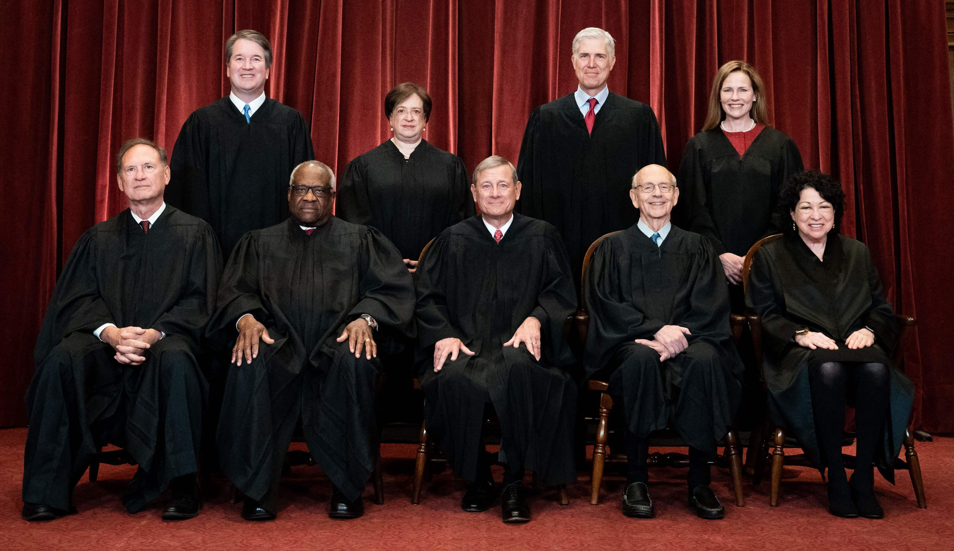


Background
2022 Dobbs ruling
reproductive health conversations
Pfizer

Slide 3
Project Goal
to help Pfizer understand public sentiment toward various birth control methods in order to develop and market their products accordingly

Slide 4
Data
~20,000 reviews from 2008-2017
acquired from drugs.com by researchers at UC Irvine
1-10 rating
7 different birth control methods

Slide 5
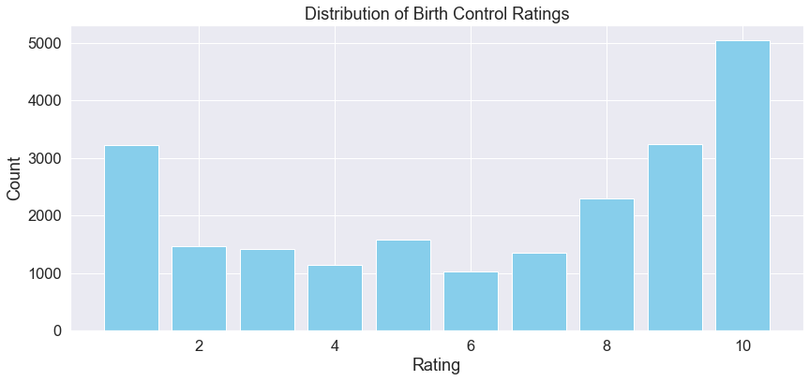
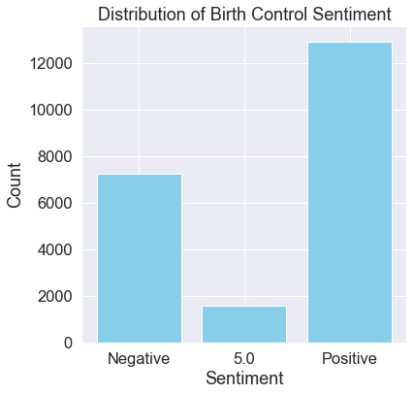

Slide 6
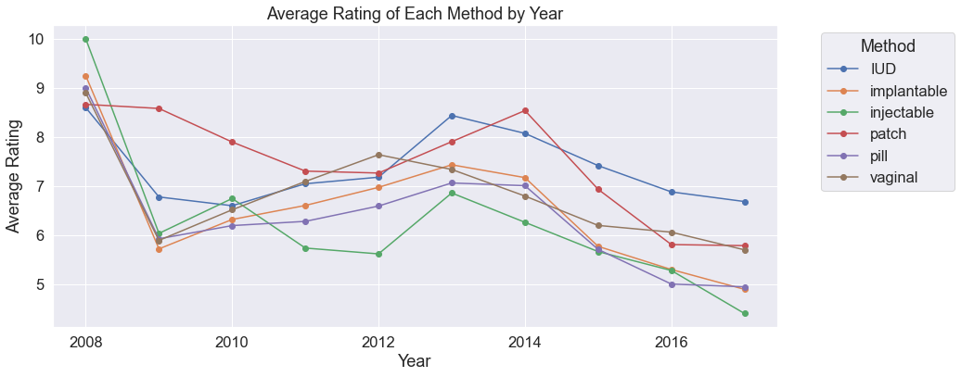

Slide 7
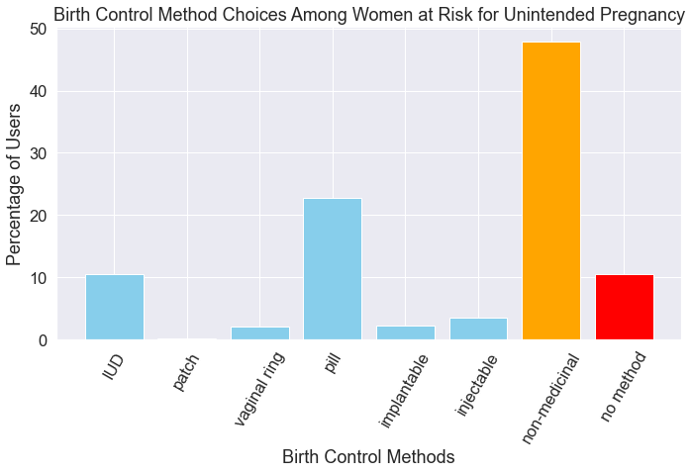
this data from the Guttmacher Institute, 2014

Slide 8
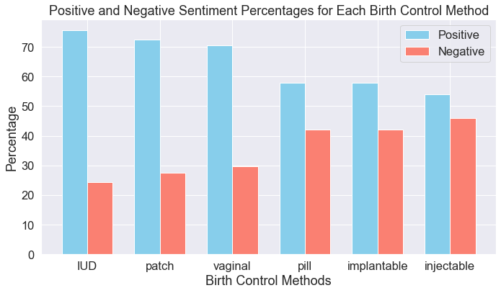

Slide 9
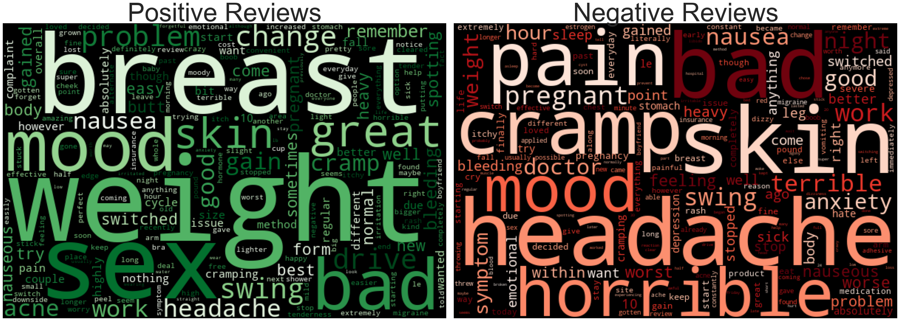
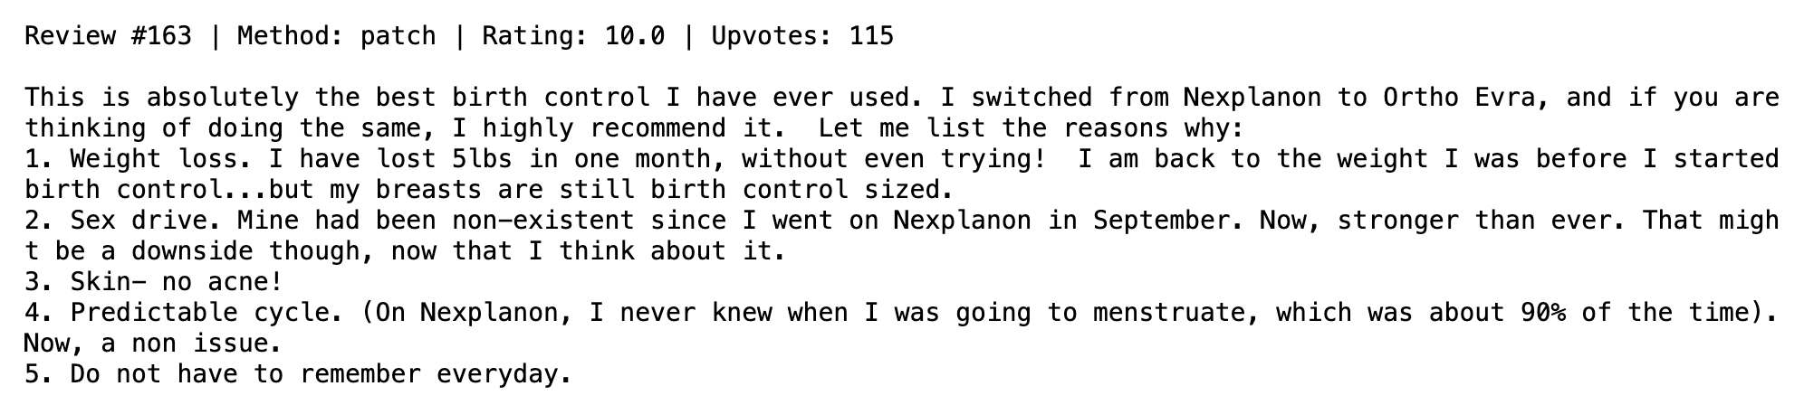
word clouds for patch reviews

Slide 10
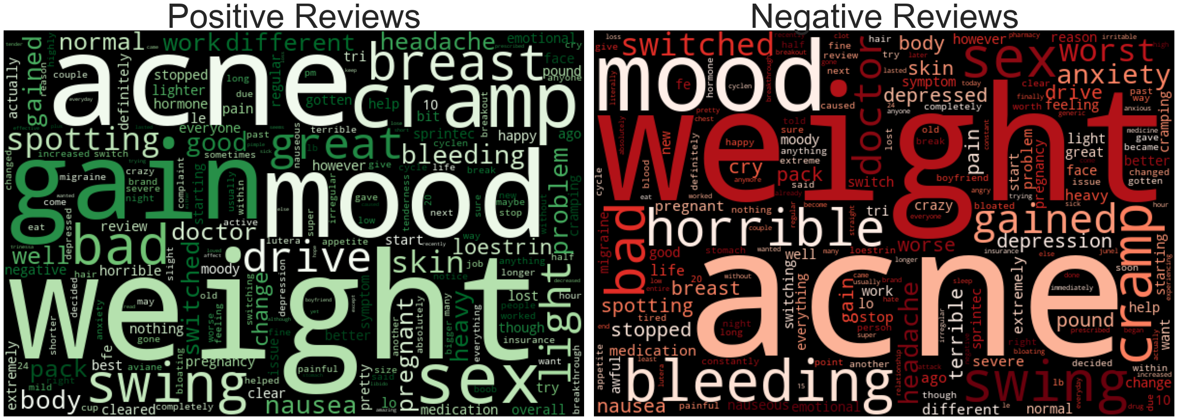
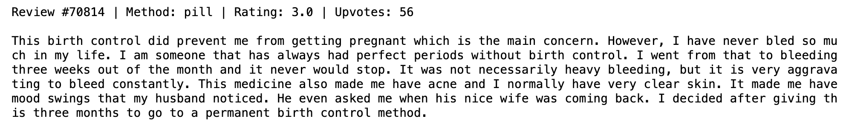
word clouds for pill reviews

Slide 11
Methods
ChatGPT3 helped with brand categorization
feature creation, e.g. readability scores
ML classifiers: Decision Tree, Random Forest, Logistic Regression*
* final model for both predictions
metrics: F1-macro for method prediction & ROC-AUC for sentiment prediction

Slide 12

Results – predicting METHODS
model | F1-macro | accuracy
Decision Tree (BASELINE) | 0.82 | 87.2%
… with hyperparameter tuning | 0.84 | 88.3%
Random Forest | 0.59 | 83.3%
… with hyperparameter tuning | 0.59 | 83.3%
Logistic Regression | 0.87 | 92.1%
… with hyperparameter tuning | 0.90 | 94.2%

Slide 13
Results – predicting SENTIMENT
model | ROC-AUC | recall | accuracy
Decision Tree (BASELINE) | 0.69 | 55.2% | 72.6%
… with hyperparameter tuning | 0.75 | 80.5% | 70.8%
Random Forest | 0.92 | 61.3% | 82.4%
… with hyperparameter tuning | 0.93 | 63.0% | 83.1%
Logistic Regression | 0.93 | 96.0% | 77.2%
… with hyperparameter tuning | 0.95 | 91.3% | 86.3%

Slide 14
Recommendations
pop-up store + event synergy = great idea
throw a party
address battery life and design issues

Slide 15
Further Inquiry
incorporate upvotes
evidence of reviewers switching brands or methods
recommendation algorithm

Slide 16
Thank you
Aaron Galbraith • 2023
www.linkedin.com/in/aarongalbraith

